Slide 1
Simulation of 8-bit ALU
Using Cadence Tool
Lakshmi Priya S

Slide 2

INTRODUCTION
Cadence Virtuoso is a comprehensive electronic design automation (EDA) tool widely used for designing custom integrated circuits (ICs), particularly in analog, mixed-signal, RF, and full-custom digital domains. It provides an end-to-end platform that supports every stage of IC design, including schematic capture, circuit simulation, physical layout, and design verification. The Virtuoso Schematic Editor allows users to create circuit diagrams, while the Virtuoso Analog Design Environment (ADE) enables detailed simulation and analysis using tools like Spectre. For layout, the Virtuoso Layout Suite offers various automation levels (XL, EXL, and GXL) to assist with physical implementation and ensure that the layout adheres to design rules and matches the schematic. Virtuoso is a preferred tool in both industry and academia for advanced custom IC design.

Slide 3
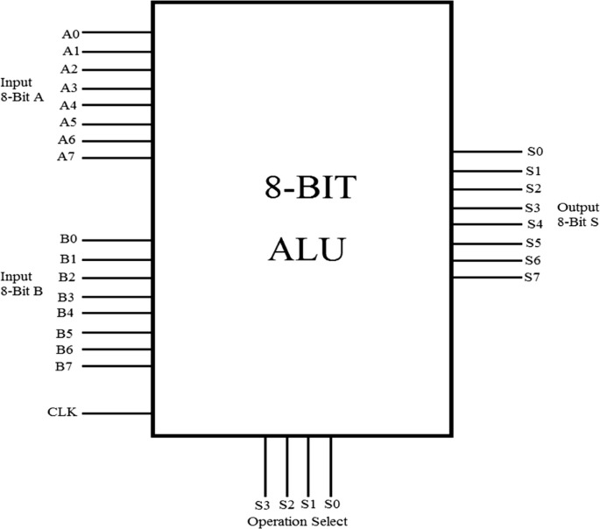
The given block diagram represents a digital 8-bit ALU (Arithmetic Logic Unit). It has two 8-bit input lines, labelled as Input A (A0–A7) and Input B (B0–B7), which supply the binary data for operations. These inputs are processed inside the ALU based on the selected operation. The Output S (S0–S7) provides the 8-bit result of the operation performed. A clock input (CLK) is included to synchronize operations, particularly if the ALU is designed for sequential logic. At the bottom, there are 4 operation select lines (S3–S0), which are used to choose the specific arithmetic or logical function to be executed (e.g., addition, subtraction, AND, OR, etc.). This structure enables the ALU to perform various operations dynamically, depending on the control input, making it a core component in digital processors and microcontrollers.

Slide 4
IMPLEMENTATION
The implementation for this system 8-Bit ALU is explained along with the code .This Verilog code defines a module named alu that implements a simple 8-bit Arithmetic Logic Unit (ALU). It takes two 8-bit inputs A and B, a 4-bit input ALU_Sel to select the operation, and outputs an 8-bit result ALU_Out along with a CarryOut flag. Inside the module, ALU_Result is a register to store the operation result, and tmp is a 9-bit wire used for carry detection. The output ALU_Out is assigned from ALU_Result, while CarryOut is set from the 9th bit of tmp, which is the result of adding A and B with a leading 0 to check overflow. An always block with sensitivity to all signals uses a case statement to execute one of the operations based on ALU_Sel. The operations include: addition (0000), subtraction (0001), multiplication (0010), division (0011), logical shift left (0100), logical shift right (0101), rotate left (0110), rotate right (0111), logical AND (1000), logical OR (1001), logical XOR (1010), logical NOR (1011), logical NAND (1100), logical XNOR (1101), greater comparison (1110, returns 255 if A > B else 0), and equality check (1111, returns 255 if A == B else 0). The default case performs addition as a fallback. The module ends with endmodule.

Slide 5
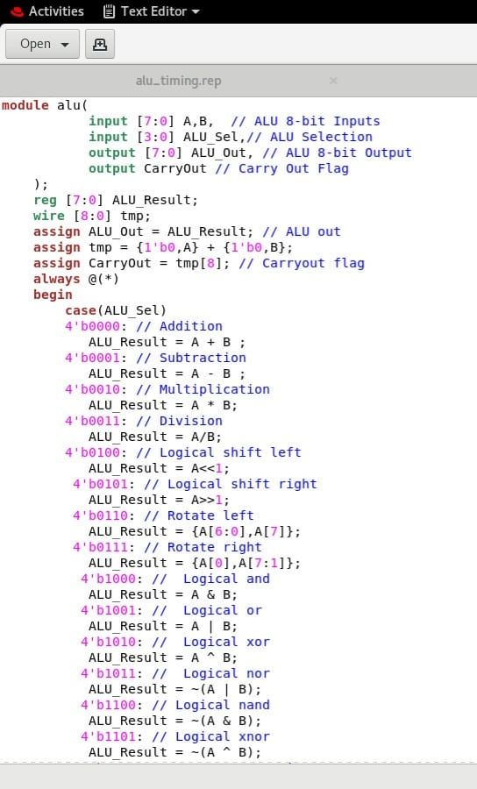
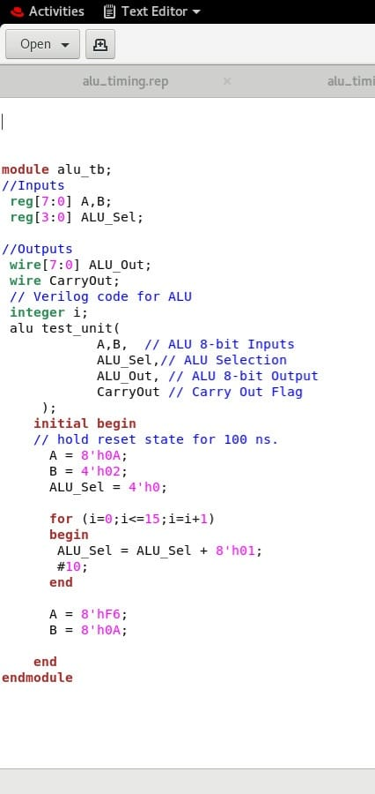
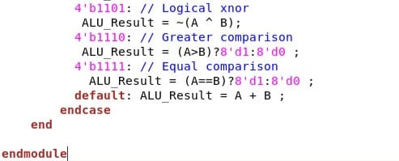

Slide 6
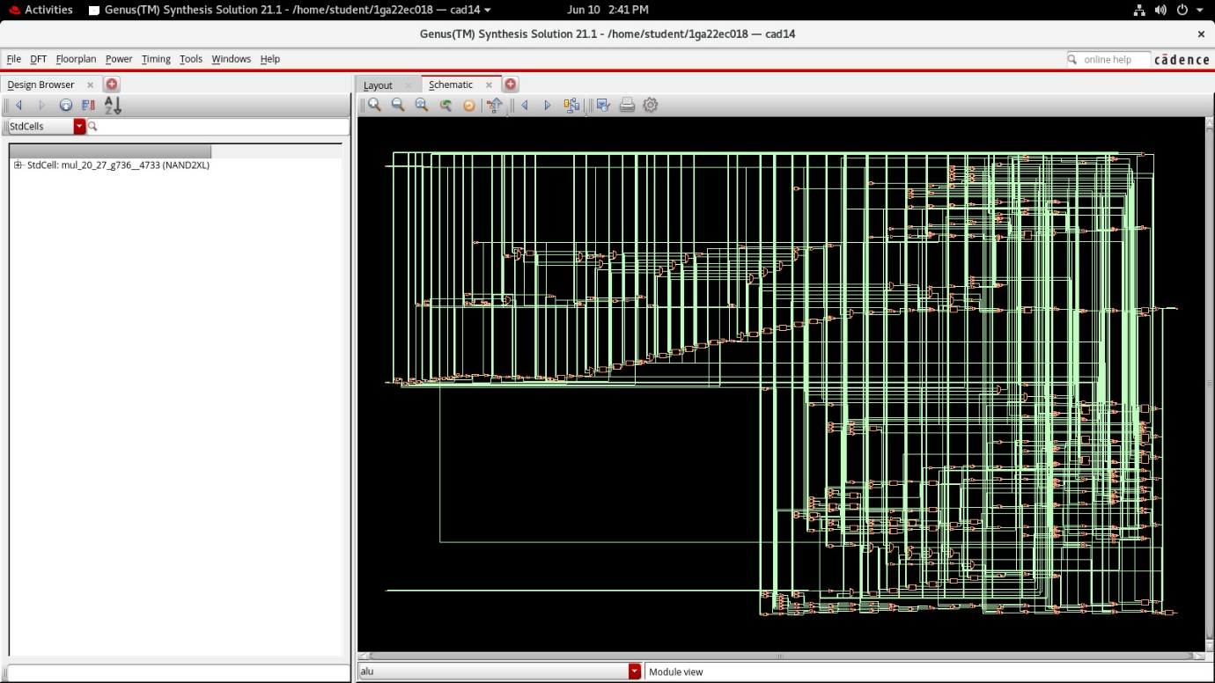
RESULT
The 8-Bit ALU provides a waveform and schematic diagram demonstrating the logical and arithmetic operation. The operations performed are addition, subtraction, multiplication, division, logical shift left, logical shift right, rotate left, rotate right, logical AND, logical OR, logical XOR, logical NOR, logical NAND, logical XNOR, greater comparison (1110, returns 255 if A > B else 0), and equality check (1111, returns 255 if A == B else 0).

Slide 7
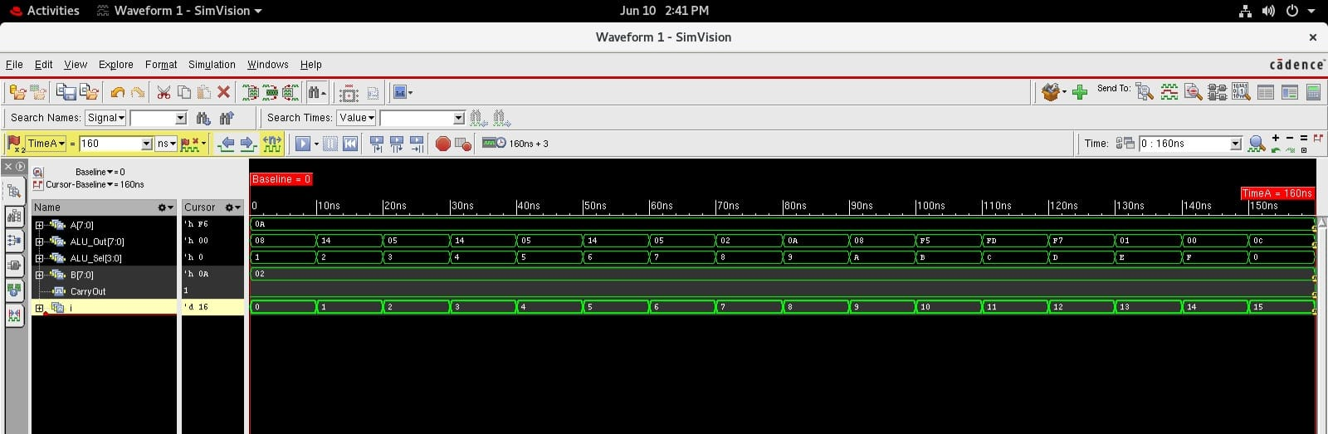

Slide 8
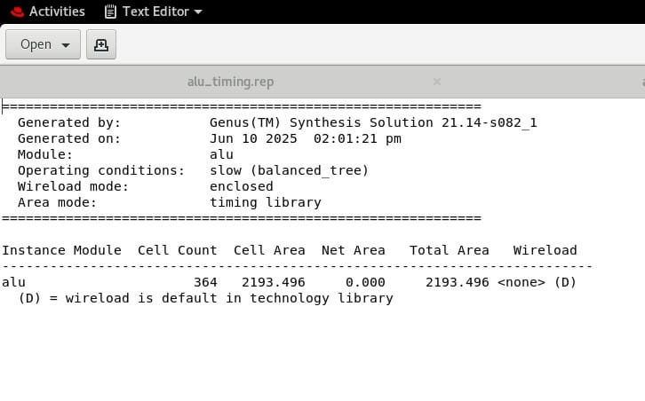
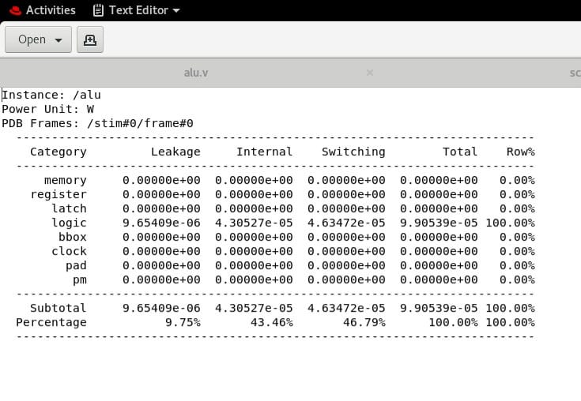
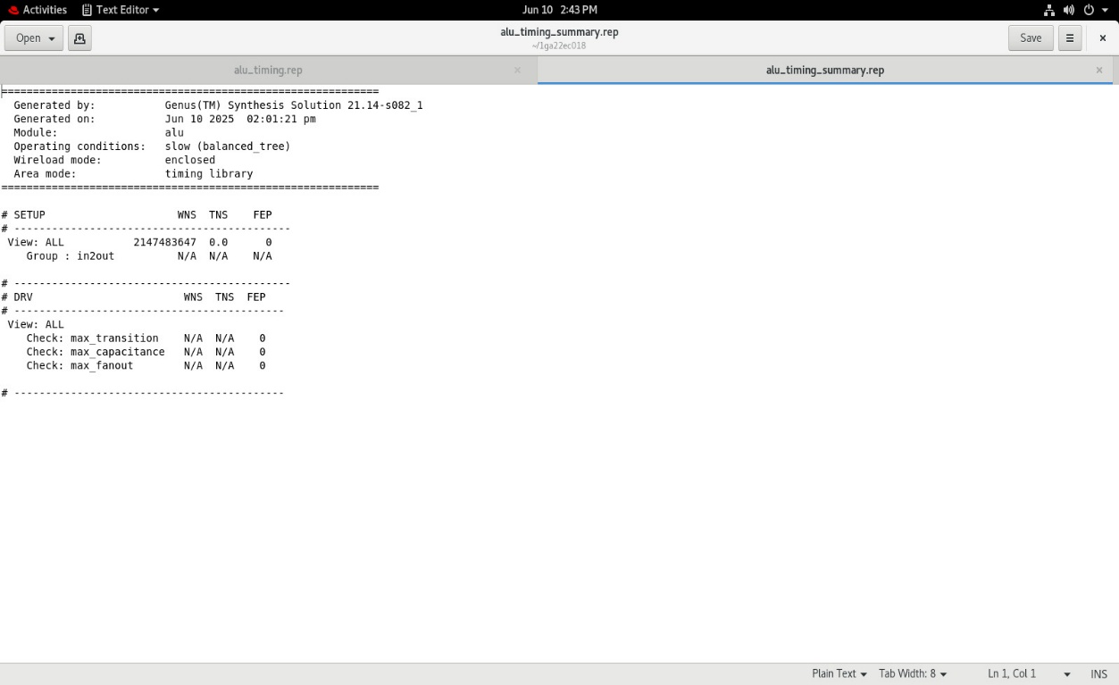
There are three ratios calculated by the schematic diagram namely: Time ratio, Power ratio and Area ratio. The ratios are shown in the figure given below.

Slide 9
The schematic diagram of a digital 8-bit ALU is a crucial part of the design process. It provides a visual representation of how different components such as adders, multiplexers, and logic gates are connected to perform arithmetic and logical operations. This schematic acts as a blueprint that helps engineers understand the data flow and structure of the ALU. It is used during the design entry phase, allowing designers to build the ALU graphically without relying solely on Verilog or VHDL code. The schematic is also essential for functional and timing simulations using tools like the Analog Design Environment (ADE), where it helps verify the circuit’s correctness and performance under various input conditions. Schematics are often used in documentation and design reviews to communicate the circuit’s design clearly to team members and stakeholders. Overall, the schematic diagram is a foundational tool in Cadence that supports the entire digital design flow—from initial design and simulation to layout and verification.
USAGE OF SCHEMATIC DIAGRAM

Slide 10
APPLICATION AND FUTURE SCOPE
The digital 8-bit ALU (Arithmetic Logic Unit) is commonly used in microcontrollers, embedded systems, digital signal processors, and simple computing devices where basic arithmetic and logical operations are required. 8-bit ALUs are ideal for applications involving low-power, cost-effective, and space-constrained environments, such as calculators, small robotics, sensors, IoT devices, and early-stage educational hardware. They perform essential functions like addition, subtraction, AND, OR, NOT, and shift operations—enabling decision-making and control logic in digital circuits. Although modern processors use 32-bit and 64-bit architectures, 8-bit ALUs are still relevant in basic digital systems. They are widely used in low-power applications, teaching tools, and custom embedded designs.
The simplicity of 8-bit ALUs makes them ideal for learning core computing concepts . In the era of IoT and edge computing, they support lightweight and efficient processing tasks . They are also valuable for prototyping in minimal hardware environments . Additionally, simplified ALUs aid in research areas like AI hardware, nanoelectronics, and quantum computing.

